Slide 1

Workloads in the cloud
Types of workloads
Packaging options
Execution options

Slide 2
New architectural concepts…
I want to motivate two design concepts…
Lambda functions
Serverless computing

Slide 3
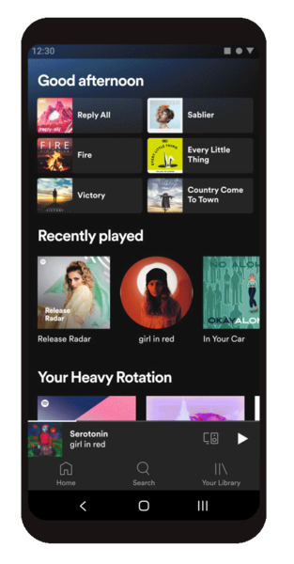
Multi-tier, data-driven apps
Our examples (so far) have all been data-driven
Notes:
Images, songs, videos, users, assets, bucket contents, …

Slide 4







Multi-tier, data-driven apps
Our examples (so far) have all been data-driven
Notes:
Images, songs, videos, users, assets, bucket contents, …

Slide 5
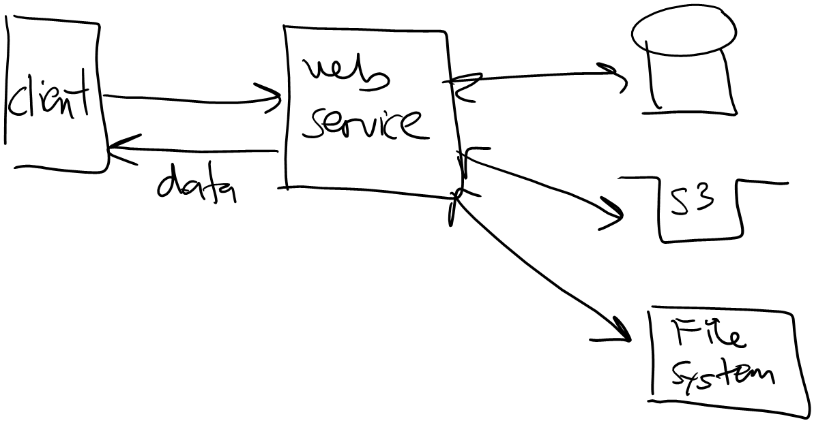
I/O bound
We call this kind of workload "I/O bound"
Server is spending most of its time waiting for requests / data, i.e. input/output
This is typically handled via async programming

Slide 6
Compute-bound
What if we need to compute something?
Image/video compression, encryption, content analysis
Stock market simulation
Run AI / ML training set
We call these "compute-bound" workloads due to heavy CPU usage… Where do we execute?
Not on the web server! It’s focus is handling incoming requests…

Slide 7
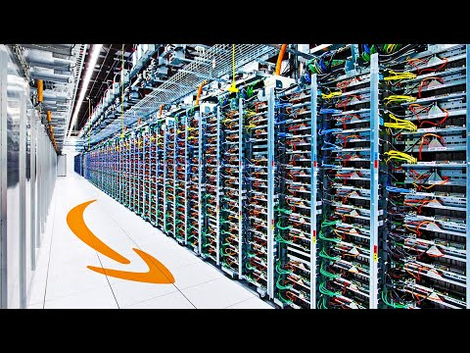
Example: prime factors in Python
https://2noicxltxjwxxt4ego5d7q4uc40bcgjw.lambda-url.us-east-2.on.aws/?n=600851475143
https://2noicxltxjwxxt4ego5d7q4uc40bcgjw.lambda-url.us-east-2.on.aws/?n=6008514751439999
import json
def prime_factors(n):
i = 2
factors = []
while i * i <= n:
if n % i:
i += 1
else:
n //= i
factors.append(i)
if n > 1:
factors.append(n)
return {
'statusCode': 200,
'body': json.dumps(factors)
}
Notes:
The 2nd URL takes 10-20 seconds

Slide 8
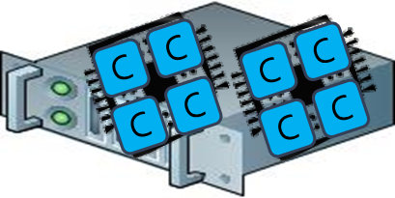
Compute tier
We need a separate tier for executing compute-bound work
This can be a separate core, CPU, or machine

Slide 9





Compute tier
We need a separate tier for executing compute-bound work
This can be a separate core, CPU, or machine

Slide 10
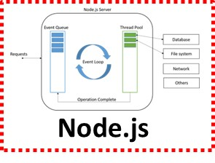
Option #1
*IF* you have unused cores available, use those
Better for small-scale work, i.e. small tasks that only run for a few seconds / minutes

Slide 11
Option #2
What if my task takes longer to run, or needs lots of RAM?
Run on separate hardware…
The problem? Installing the software you want to run…

Slide 12
Elastic Compute Cloud (EC2)
Everything runs on an EC2 instance…
EC2 is AWS machine rental service, started in 2006
Outsourcing hardware is an old idea. Amazon's innovation was to charge by the hour, not month, and this started cloud revolution
12

Slide 13
Software packaging options
EC2
EKS
ECS
Fargate
Elastic Beanstalk
API Gateway + Lambda
Lambda
Virtual Machine Image
Docker
Container
Program
(e.g. web service)
function
function
function
function
Notes:
EC2 = Elastic Compute Cloud
EKS = Elastic Kubernetes Service
ECS = Elastic Container Service
Fargate = Amazon's serverless container service --- Lambda does functions, Fargate does containers
EB = Elastic Beanstalk

Slide 14
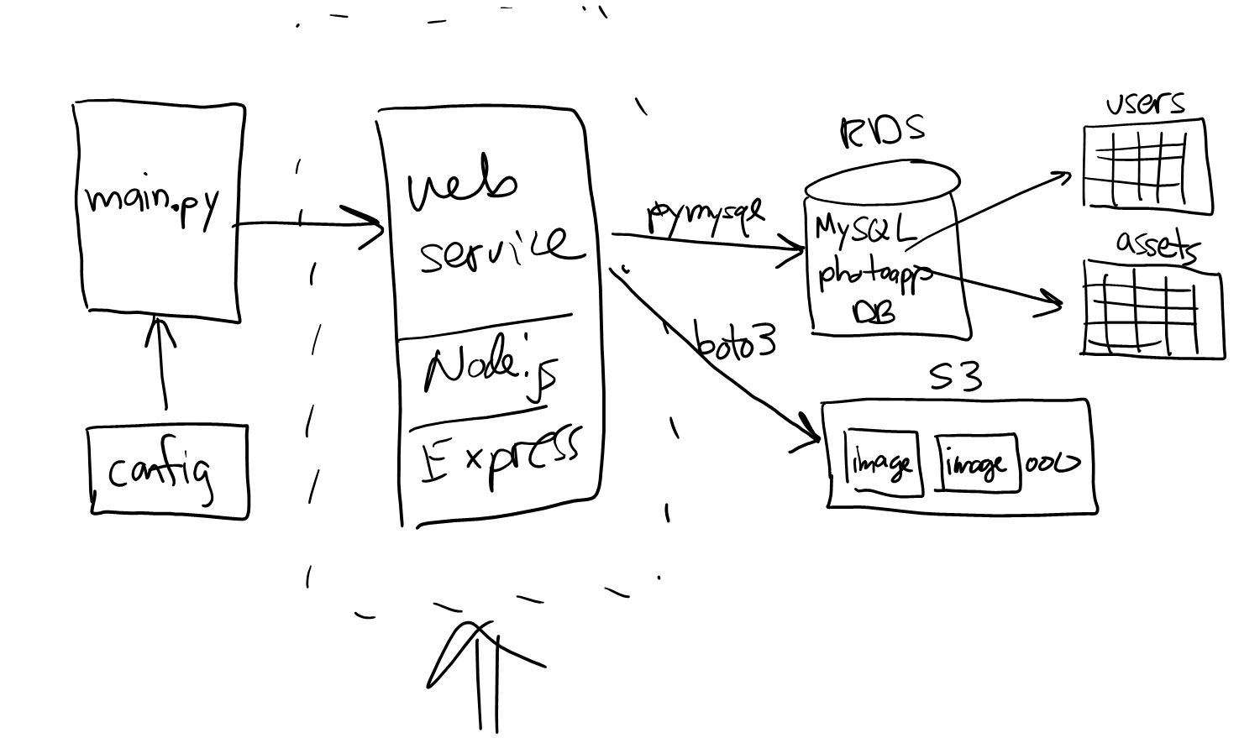
Example
Elastic Beanstalk
Program
(e.g. web service)
In project 02, EB allowed us to have a web service up and running with .zip and a few button clicks…
EB

Slide 15
Execution continuum
Trade-offs:
EC2, EKS, ECS, Fargate
Elastic Beanstalk
API Gateway + Lambda
Lambda
Run any software you want for as long as you want
Complete control over HW and SW
Hardest to config
Server-based
Upload .zip file
Limited software choices
Some control over HW and SW
Function based
Near-zero config
Multi-tier web service + functions (15-min limit)
Function based
Near-zero config
Short execution (< 15 mins)
Notes:
Next time? We’ll focus on lambda…

Slide 16
That's it, thank you!

Slide 17
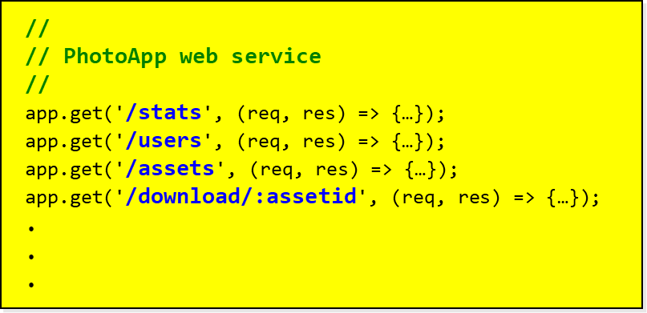
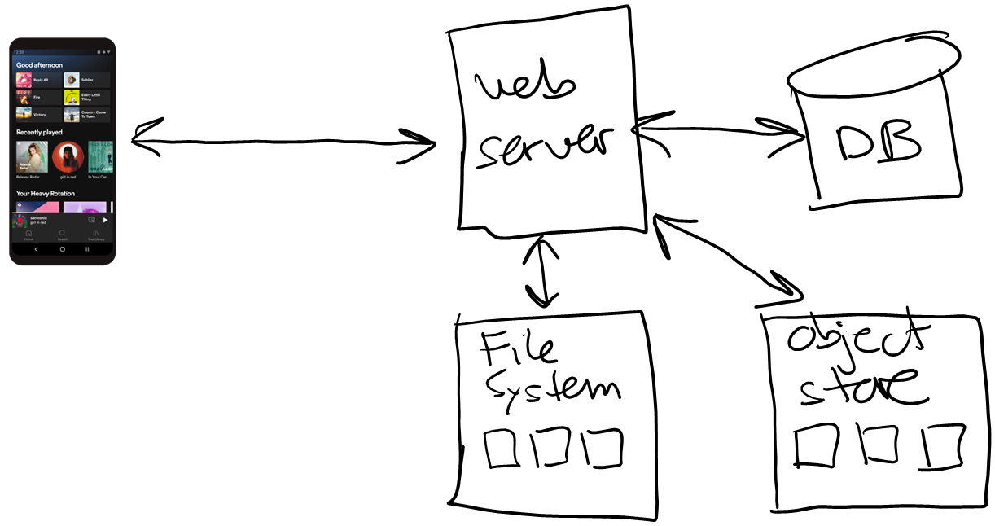









Workloads
Server functions often fall into one of two categories
I/O-bound
Input/output operations
Example: reading / writing files
Example: calls to RDS or S3
Compute-bound
CPU-intensive operations
Example: image encoding / resizing
Example: file compression / encryption
Example: training ML models

Slide 18
Compute-bound work
Compute-bound work should be executed on a different core / CPU / machine
Otherwise the main thread focuses on compute-bound work and ignores incoming requests / async completions

Slide 19
Options in AWS
The workload may run for hours or days? => EC2
Pre-defined image of your program is saved in S3
Start virtual machine (VM), load program, run it, save results in DB / S3?
The work may run for < 15 mins? => Lambda
Think function instead of program…
Pre-defined copy of your function is saved in S3
AWS allocates VM, loads function, calls it, returns result
Work may run for few secs / mins? => multi-threading
Create separate thread within your existing program
Have thread execute function, OS will run on a different core
[ Node.js supports via worker_threads, but not a great idea unless running on multiple cores. ]

Slide 20
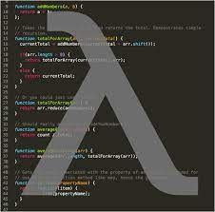












Slide 21
app.get('/stats', (req, res) => {
s3_response = s3.send("HeadBucketCommand"));
rds_response = new Promise((…) => {
db.query(`Select count(*) from users; Select count(*) from assets;`);
});
Promise.all([s3_response, rds_response]).then(results => {
res.json(…);
}).catch(err => {
res.json(…);
});
});

Slide 22












Slide 23

DB
DB

Slide 24

DB

